Slide 1

ECE 530 Cloud Computing
Ioannis Papapanagiotou
Service Level Agreements

Slide 2
Service Level Agreements
Document!
A cloud SLA (cloud service-level agreement) is an agreement between a cloud service provider and a customer that ensures a minimum level of service is maintained.
It guarantees levels of reliability, availability and responsiveness to systems and applications, while also specifying who will govern when there is a service interruption.

Slide 3
Why do we need SLAs?
A cloud infrastructure can span geographies, networks and systems that are both physical and virtual.
While the exact metrics of a cloud SLA can vary by service provider, the areas covered are uniform: volume and quality of work -- including precision and accuracy -- speed, responsiveness and efficiency.
The document aims to establish a mutual understanding of the services, prioritized areas, responsibilities, guarantees and warranties provided by the service provider.

Slide 4
How?
Metrics and responsibilities among the parties involved in cloud configurations are clearly outlined, such as the specific amount of response time for reporting or addressing system failures.
Financial penalties a provider must pay for failing to live up to the guaranteed terms are also included. These penalties are often in the form of credits for service time.

Slide 5
Service Level Agreement (SLA)
SLAs are used widely at many Web Sercivces
Sub-services must meet strict SLAs
e.g., 300ms response time for 99.9% of requests at peak load of 500 requests/s
Average-case SLAs are not good enough
Amazon did a cost-benefit analysis that uses 99.9% percentile
Rendering a single page can make requests to 150 services

Slide 6
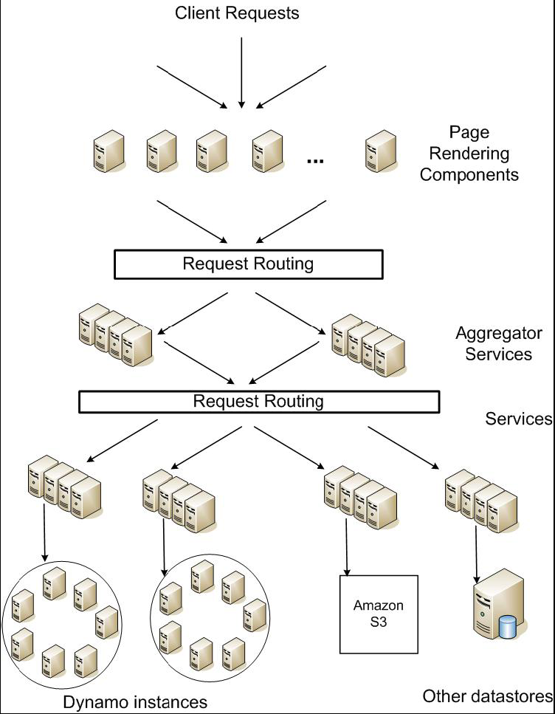
Service Level Agreements (SLA)
Application can deliver its functionality in a bounded time:
Every dependency in the platform needs to deliver its functionality with even tighter bounds.
Example:
service guaranteeing that it will provide a response within 300ms for 99.9% of its requests for a peak client load of 500 requests per second.
Service-oriented architecture of
Amazon’s platform

Slide 7
Design Consideration
Sacrifice strong consistency for availability
Conflict resolution is executed during read instead of write, i.e. “always writeable”.
Other principles:
Incremental scalability.
Symmetry.
Decentralization.
Heterogeneity.

